Slide 1
EDA Case Study
-Bank Loan
By:- Amit Chawla and Harnoor Singh

Slide 2
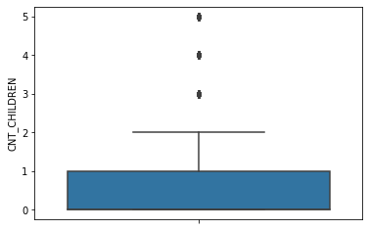
Loan application - CNT_CHILDREN
As we can observe, loan are mostly applied by clients with 0 or 1 children.
There are also some data points where clients have 2-5 children.

Slide 3
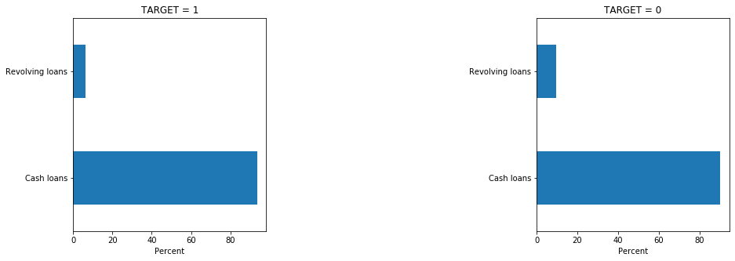
Type of loan and payback
There are slightly more data points for TARGET = 0, where clients had no difficulty in payment for revolving loans. So, clients who opted for revolving loans are slightly more likely to pay back without difficulty

Slide 4
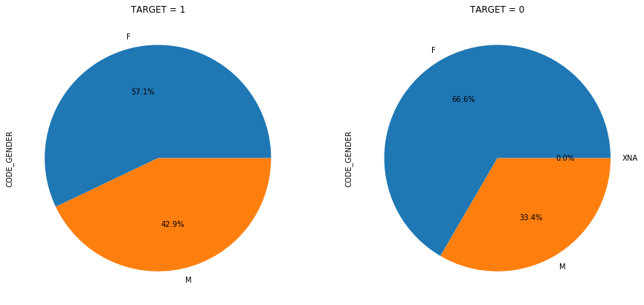
Gender distribution on TARGET
For clients who had payment difficulty, around 57% of them whereas females, where males were around 43%.
For clients who had no payment difficulty, around 65% of them whereas females, where males were around 33.5%.

Slide 5
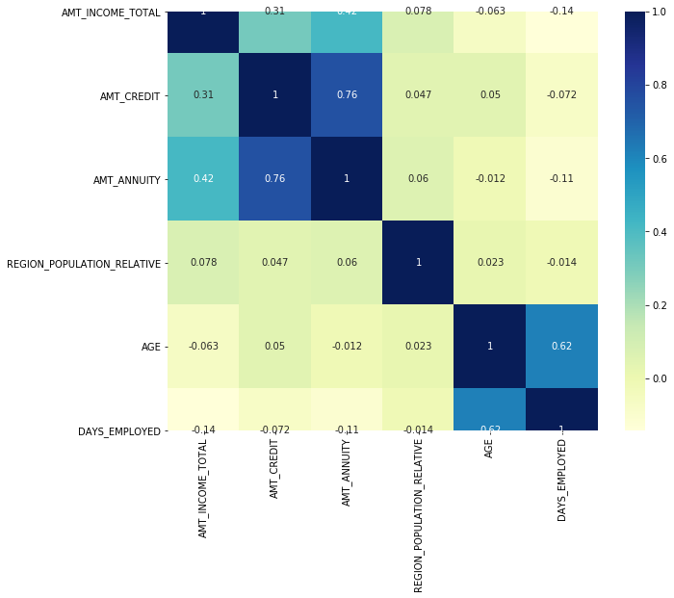
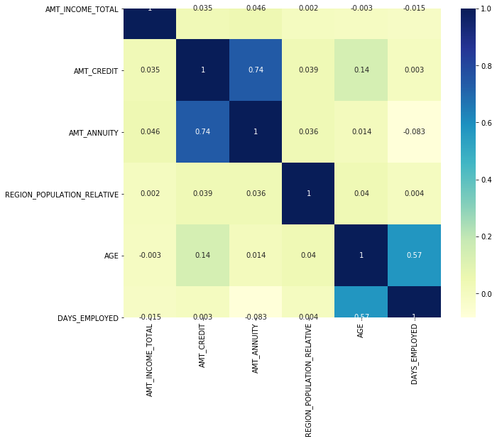
TARGET based Correlation
TARGET = 0
TARGET = 1

Slide 6
...contd Correlation
AMT_CREDIT And AMT_ANNUITY have the highest correlation in both the data sets
These are even more correlated for target 0 i.e for the cases where there is not default

Slide 7
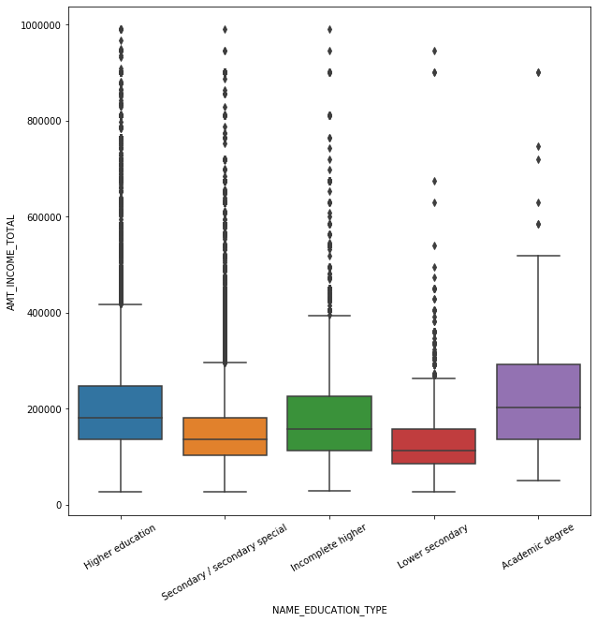
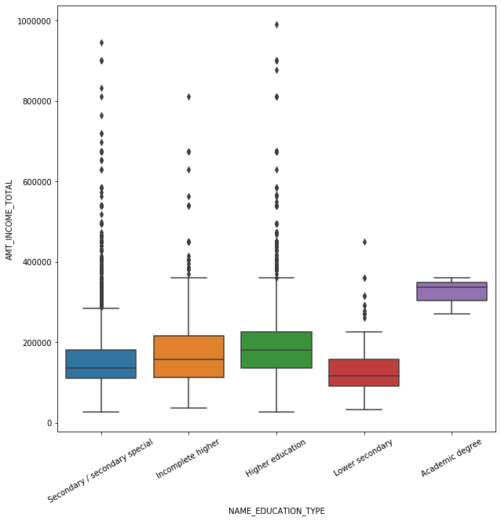
TARGET based AMT_INCOME_TOTAL vs NAME_EDUCATION_TYPE
TARGET = 0
TARGET = 1

Slide 8
...contd AMT_INCOME_TOTAL vs NAME_EDUCATION_TYPE
For TARGET = 1 (clients who default)
Although Academic degree seems to be in higher range, there are only 3 cases of default for clients with Academic degree and those are in middle income range.
Clients with Lower secondary education level are more likely to default for AMT_INCOME_TOTAL < 400000
For TARGET = 0 (clients who do not default)
Majority of on time paying clients lies in higher range of AMT_INCOME_TOTAL
Clients with Lower secondary who opted for large sum of loan (945000.0) have paid on time while clients of same education who took loans of moderate size (450000.0) have defaulted.

Slide 9
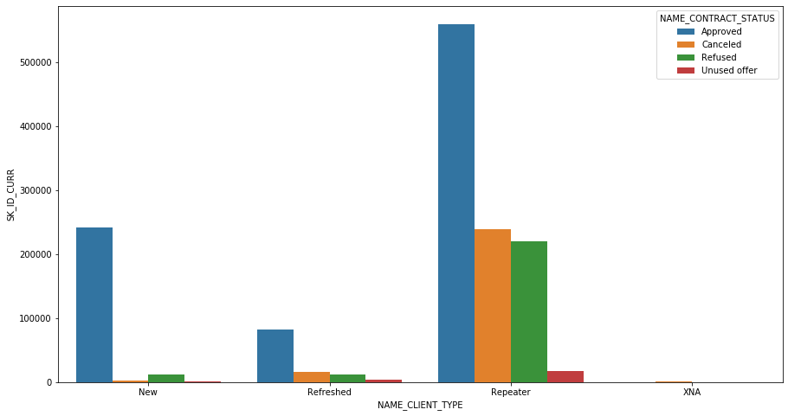
NAME_CONTRACT_STATUS based NAME_CLIENT_TYPE

Slide 10
...contd NAME_CLIENT_TYPE
The count of repeaters is high, clients are loyal to the bank
The Approved percentage is high for New, Refresher and Repeater. It is significantly higher for Repeater.
The percentage for Canceled and Refused is also significantly higher for Repeater.
Refreshed clients have slightly higher Canceled percentage as compared to New clients

Slide 11

Highest AMT_APPLICATION loans
We observed that highest AMT_APPLICATION for loan amounted to 58.5 Lacs.
The loan was approved.
Client who applied for this loan has successfully paid back on time without default.

Slide 12
Final Words...
Loan applications are mostly from clients having 0 or 1 children and the loan amount is mostly less than 5 Lakhs.
Females have a high percentage in both, defaulting a loan and paying back on time.
Clients with Lower secondary education level are more likely to default for AMT_INCOME_TOTAL < 400000
The count of Repeaters is high, clients are loyal to the bank
Highest number of people who have applied for loan and defaulted are in age of 25-40 years.

Slide 13
...contd Final Words
Mostly payments are done by cash through the bank by clients.
Very high AMT_APPLICATION (greater than 50 Lac) was approved and the client successfully paid back on time.
For people with income more than 10 lac there is very less risk of default
AMT_CREDIT And AMT_ANNUITY have the highest correlation

Slide 14
Thank you!
By:- Harnoor Singh and Amit Chawla

